Slide 1
Exceptions, Interrupts, and Timers
10.1 Exception Handling and Signals
Interrupt Service Routines
Timers
Notes:
Exception handling
Using signals
Installing user-defined signal handler

Slide 2
Exception Handling Overview
An exception is an unplanned event generated by the CPU. Examples include: trap or breakpoint instruction, divide by zero, floating point or integer overflow, illegal instruction, or address error.
An exception will generate an “internal” interrupt.
VxWorks installs exception handlers at system startup. These handlers will run on an exception and will try to invoke a user-defined exception handler.
A VxWorks exception handler communicates with a user tasks by sending a signal. The user-installed handler will then run.
Notes:
Exceptions vary across CPU architectures. The help page for excLib contains information about generic exception handling, while the page for excArchLib discusses architecture-specific routines.

Slide 3
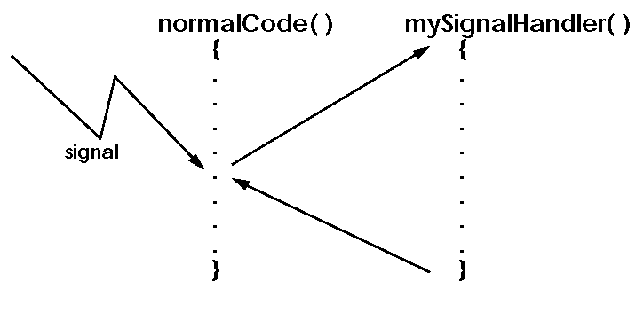
Signals
Notes:
A signal is the software analog of an interrupt:
A signal sent to a task indicates some asynchronous event has occurred.
There are 31 unique signals, each representing a different event.
A task can attach a signal handler to take appropriate action when the signal is received.
Upon completion of signal handling, normal task execution is resumed (unless the signal corresponds to an exception).
For more information on signals, see Advanced Programming in the UNIX Environment by Stevens.

Slide 4
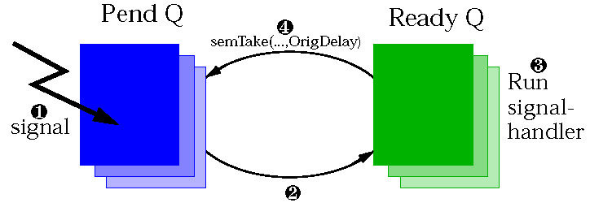
UNIX: UNIX vs. VxWorks Signals
Signal is ignored if no handler is installed.
“Automatic function restarting”
Can install a handler to catch SIGKILL.
No SIGCHLD, SIGPIPE, or SIGURG.
taskDelay( ) sets errno = EINTR and returns ERROR if interrupted by a signal.
Notes:
1. Task receives a signal while pended.
2. Task is removed from pend queue and made ready to run.
3. When the task is the highest priority task on the Ready queue, it runs its signal handler for the signal it caught.
4. After running its signal handler, the task is returned to the pended state, with its originally specified timeout.
“Automatic function restarting” describes behavior for a task which catches a signal while on the pend queue:

Slide 5
Caveats
Signals are not recommended for general intertask communication. A signal:
  May be handled at too high a priority if it arrives during a priority inheritance.
  Disrupts a task’s normal execution order. (It is better to create two tasks than to multiplex processing in one task via signals.)
  Can cause reentrancy problems between a task running its signal handler and the same task running its normal code.
  Can be used to tell a task to shut itself down.
sigLib contains both POSIX and BSD UNIX interfaces. Do not mix them.
Notes:
Consider a task which enters a critical region by taking a mutex semaphore guarding some shared resource. Suppose the task receives a signal while in the critical region. If the signal handler also attempts to take the mutex, it will succeed, and the resource may be corrupted.
Include signal.h or sigLib.h when programming with signals.
To send a (non-exception) signal use the kill (tid, signo) function. Use sigqueue ( ) to send queued signals.

Slide 6
Registering a Signal Handler
To register a signal handler:
signal (signo, handler)
  signo Signal number.
  handler Routine to invoke when signal arrives (or SIG_IGN to ignore signal).
  Returns the previously installed signal handler, or SIG_ERR.
The signal handler should be declared as:
  void sigHandler (int sig); /* signal number */
Notes:
A VxWorks signal handler is passed not only the signal number but also two additional parameters. To access these additional parameters, declare your signal handler as
void sigHandler
(
int sig, /* signal number */
int code, /* additional code */
struct sigcontext * pSigCtx
);
The code argument can be used to distinguish different exceptions which generate the same signal. See sigLib for the architecture specific codes. The pSigCtx argument points to saved context information for the task which received the signal. Its use is architecture dependent.
A third signal handler prototype is used for signals generated by sigqueue ( ) and some routines in the POSIX Real-Time Extensions libraries. See sigLib for details.

Slide 7
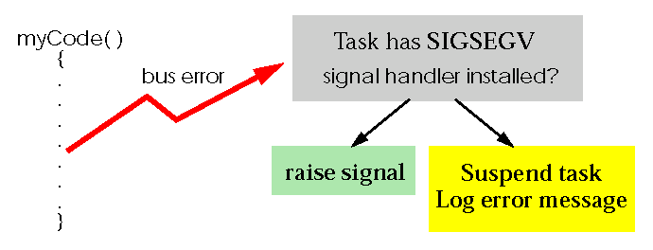
Signals and Exceptions
Hardware exceptions include bus error, address error, divide by zero, floating point overflow, etc..
Some signals correspond to exceptions (e.g., SIGSEGV corresponds to a bus error on a 68k; SIGFPE corresponds to various arithmetical exceptions).
Notes:
When an executing task generates an exception:
If the task has a signal handler installed to deal with that exception, VxWorks will raise the signal to that task.
If the task has no signal handler installed for that exception, VxWorks will suspend the task and log an error message to the console.
The correspondence between signals and exceptions is architecture dependent. See sigLib.

Slide 8
The Signal Handler
If an exception signal handler returns:
  The offending task will be suspended.
  A message will be logged to the console.
Exception signal handlers typically call:
  exit( ) to terminate the task, or
  taskRestart( ) to restart the task, or
  longjmp( ) to resume execution at location saved by setjmp( ).
@
Notes:
For more information on setjmp( )/longjmp( ), see the online documentation or Advanced Programming in the UNIX Environment by Stevens.
Signal handlers responding to asynchronously generated signals (sent by another task or ISR) should return rather than exit non-locally with exit(), taskRestart(), or longjmp(). Such non-local exits, occurring in a signal handler called at an indeterminate point in the task’s execution, can leave shared resources (e.g., the system memory pool) corrupted. See also the reference entry for sigprocmask() for blocking signals during critical sections of a task’s execution.
See the Exception Handling example in Appendix A.

Slide 9
Exceptions, Interrupts, and Timers
Exception Handling and Signals
10.2 Interrupt Service Routines
Timers
Notes:
ISR Basics
ISR Restrictions

Slide 10
Interrupts
Interrupts allow devices to notify the CPU that some event has occurred.
A user-defined routine can be installed to execute when an interrupt arrives.
This routine runs at interrupt time. It is not a task.
On-board timers are a common source of interrupts. Using them requires understanding interrupts.

Slide 11
Device Drivers
Use interrupts for asynchronous I/O.
Are beyond the scope of this course.
For more information:
  intArchLib To install user defined ISR’s.
  Board Support Package Board-specific interrupt handling.
  Programmers Guide Architecture specific interrupt info.
  Tornado User’s Guide System mode debugging info.
  BSP Porting Kit Optional product for writing BSP’s.
  VxWorks Device Write VMEbus and VxWorks
  Driver Workshop standard device drivers.
  Tornado BSP BSP-specific interrupt issues, such
  Training Workshop as interrupt controllers and busses.

Slide 12
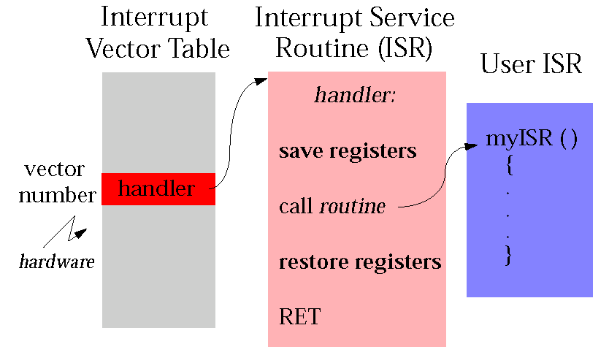
Interrupt Handling Example (68k)
Notes:
When an interrupt occurs:
1. Switch to a dedicated interrupt stack (except for x86, R6000, CPU-32, MC68060, MC68000, and MC68010 which take interrupts on task stacks.).
2. In handler wrapper routine, save volatile registers and errno.
3. Call user-defined interrupt handler from handler wrapper.
4. On return from handler, restore values previously saved and return from interrupt level. May result in a reschedule of the previously executing task if a higher priority task was made ready to run.
User-defined interrupt handler code can be installed by intConnect( ).

Slide 13
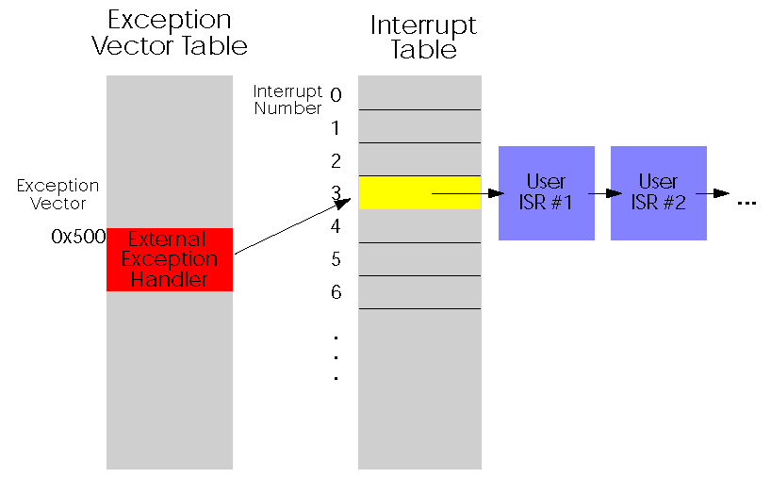
Interrupt Handling Example (PowerPC)
Notes:
The PowerPC has a single external interrupt pin. A BSP may support an external interrupt controller to support nested interrupts. For details, see excArchLib and VxWorks Programmer’s Guide appendix on PowerPC.
The number of entries in the interrupt table is dependent on which interrupt controller(s) your BSP supports. ISRs may be chained for a given BSP.
The VxWorks external exception handler:
saves CPU registers
reads interrupt number from interrupt controller
sequentially calls all chained interrupts at that number
communicates to interrupt controller that ISR is complete
restores CPU registers and returns

Slide 14
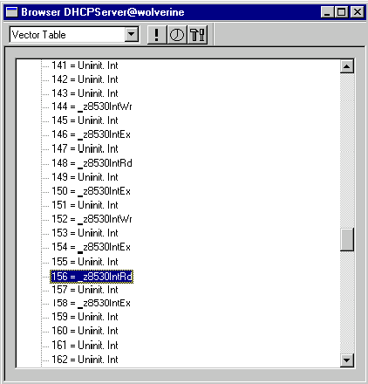
Displaying the Interrupt Vector Table
To show the interrupt vector table from the Browser, choose Vector Table in the selector box (Windows), or click on the Interrupt button (UNIX).
Notes:
Not all CPU architectures support an interrupt vector table.
This screenshot displays a portion of the interrupt vector table on a mv162 BSP (MC68040 CPU). Interrupt numbers 144, 146, 148, 150, 152, 154, 156, and 158 are mapped by this BSP to interrupts from the board’s Z8530 serial communications controller. The highlighted entry, 156, has installed handler _z8530IntRd, the receive ISR for this serial device.
Note that the same handler is also installed at number 148, because the Z8530 has two ports, each with its own installed ISRs. If the table we see _z8530IntRd at number 148 (SCC 1, channel B), and 156 (SCC 1, channel A). The interrupt mapping for this BSP is done set in mv162.h, sysSerial.c, sysScsi.c, and sysLib.c.

Slide 15
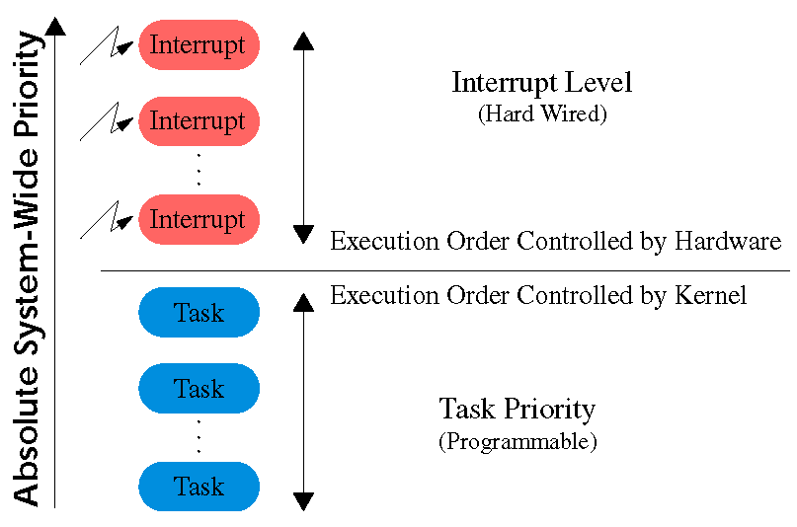
Interrupts and Priorities
Notes:
Interrupts preempt even highest priority task.

Slide 16
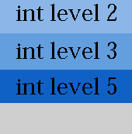
Interrupt Stack
Most architectures use a single dedicated interrupt stack.
Interrupt stack is allocated at system start-up.
The interrupt stack size is controlled by the macro INT_STACK_SIZE; default value defined in configAll.h.
Must be large enough for worst-case nesting.
Interrupt Stack
Notes:
x86, CPU-32, R6000, MC68060, MC68000, and MC68010 are CPU’s which use tasks’ stacks for processing interrupts. Consequently, each task’s stack must have enough extra space to handle the worst-case nesting of interrupts.
Use checkStack( ) or the Browser to check task stacks for stack crashes. Interrupt stacks may be checked manually; on many architectures, the variables vxIntStackBase (where the stack starts) and vxIntStackEnd (towards which the stack grows) identify the ends of the interrupt stack region. Dump memory from vxIntStackEnd to vxIntStackBase. The location where the 0xee bytes stop indicates the high water mark of ISR stack usage.

Slide 17
ISR Restrictions
No tasks can run until ISR has completed.
ISR’s are restricted from using some VxWorks facilities. In particular, they can’t block:
  Can’t call semTake( ).
  Can’t call malloc( ) (uses semaphores).
  Can’t call I/O system routines (e.g., printf( )).
The Programmer’s Guide gives a list of routines which are callable at interrupt time.
Notes:
The one I/O system call which can be made from an ISR is write( ) to a pipe.

Slide 18
ISR Guidelines
Keep ISR’s short, because ISR’s:
  Delay lower and equal priority interrupts.
  Delay all tasks.
  Can be hard to debug.
Avoid using floating-point operations in an ISR.
  They may be slow.
  User must call fppSave( ) and fppRestore( ).
Try to off-load as much work as possible to some task:
  Work which is longer in duration.
  Work which is less critical.

Slide 19
Typical ISR
Reads and writes memory-mapped I/O registers.
Communicates information to a task by:
  Writing to memory.
  Making non-blocking writes to a message queue.
  Giving a binary semaphore.

Slide 20
Debugging ISR’s
To log diagnostic information to the console at interrupt time:
    logMsg (“foo = %d\n”, foo, 0, 0, 0, 0, 0);
  Sends a request to tLogTask to do a printf( ) for us.
Similar to printf( ), with the following caveats:
  Arguments must be 4 bytes.
  Format string plus 6 additional arguments.
Use a debugging strategy which provides system-level debugging:
  WDB agent.
  Emulator.
Notes:
Related logLib routines:
logFdSet Set file descriptor for logging output (default is the console).
logFdAdd Add file descriptor for logging output.
In system mode, CrossWind can be used with the WDB agent or an emulator to obtain diagnostic information.
Debug as much code as possible from task level before executing from interrupt level.

Slide 21
Exceptions at Interrupt Time
Cause a trap to the boot ROM’s.
Logged messages will not be printed.
Boot ROM program will display an exception description on reboot.
An exception occurring in an ISR will generate a warm reboot.
Can use sprintf( ) to print diagnostic information to memory not overwritten on reboot, if necessary.
Notes:
During a cold reboot, RAM is zeroed to avoid parity errors the first time memory is read. This step is skipped on a warm reboot.
If you are unsure how your architecture responds to a particular exception in an ISR, execute code causing that exception from interrupt level (e.g. in a watchdog; see the Timers section of this chapter) and check memory after the reboot. The typical architecture-specific memory maps in the Programmer’s Guide may be of use as a starting point in deciding where to sprintf diagnostic information.

Slide 22
Exceptions, Interrupts, and Timers
Exception Handling and Signals
Interrupt Service Routines
10.3 Timers
Notes:
System clock interrupt service routine
Watchdog timers
Auxiliary clock

Slide 23
Timers
On-board timers interrupt the CPU periodically.
Timers allow user-defined routines to be executed at periodic intervals, which is useful for:
  Polling hardware.
  Checking for system errors.
  Aborting an untimely operation.
VxWorks supplies a generic interface to manipulate two timers:
  System clock.
  Auxiliary clock (if available).
Notes:
If your board has other timers, you may write additional drivers to manipulate them.

Slide 24
System Clock
System clock ISR performs book-keeping:
  Increments the tick count (use tickGet( ) to examine the count).
  Updates delays and timeouts.
  Checks for round-robin rescheduling.
These operations may cause a reschedule.
Default clock rate is 60hz.
  sysClkRateSet (freq) Sets the clock rate.
  int sysClkRateGet( ) Returns the clock rate.
sysClkRateSet( ) should only be called at system start-up.
Notes:
The global variable vxAbsTicks is a 64-bit count which rolls over exactly once each 264 ticks of the system clock:
typedef struct
{
ULONG lower;
ULONG upper;
} TICK;
TICK vxAbsTicks;
vxAbsTicks.lower rolls over exactly once every 232 ticks; when this happens, vxAbsTicks.upper is incremented by 1.
The tickGet( ) function returns vxAbsTicks.lower.

Slide 25
Watchdog Timers
User interface to the system clock.
Allows a C routine to execute after a specified time delay.
Upon expiration of delay, connected routine runs.
  As part of system clock ISR.
  Subject to ISR restrictions.

Slide 26
Creating Watchdog Timers
To create a watchdog timer:
WDOG_ID wdCreate ()
  Returns watchdog id, or NULL on error.
To start (or restart) a watchdog timer:
STATUS wdStart (wdId, delay, pRoutine, parameter)
  wdId Watchdog id, returned from wdCreate( ).
  delay Number of ticks to delay.
  pRoutine Routine to call when delay has expired.
  parameter Argument to pass to routine.
Notes:
wdStart( ) will cause the watchdog routine to run once when the specified delay expires. To get periodic execution, the watchdog routine must call wdStart( ) to restart itself.
Only the most recent wdStart( ) on a watchdog timer will run: to run multiple watchdog ISR’s, you must use multiple watchdog timers.
WDOG_ID defined in wdLib.h.

Slide 27
Using Watchdogs
To use watchdogs for periodic code execution:
The doit( ) routine might:
  Poll some hardware device.
  Unblock some task.
  Check if system errors are present.
wdId = wdCreate();
wdStart (wdId, DELAY_PERIOD, myWdIsr, 0);
void myWdIsr(int param)
{
doit (param);
wdStart (wdId, DELAY_PERIOD, myWdIsr, param);
}

Slide 28
Missed Deadlines
To recover from a missed deadline:
WDOG_ID wdId;
void foo(void)
{
wdId = wdCreate( );
/* Must finish each cycle in under 10 seconds */
FOREVER
{
wdStart (wdId, DELAY_10_SEC, fooISR, 0);
fooDoWork( );
}
}
void fooISR (int param)
{
/* Handle missed deadline */
...
}
Notes:
The above code demonstrates a technique for recovering from missed deadlines. The fooDoWork( ) must run every 10 seconds. If it takes less than 10 seconds, the watchdog is restarted (and fooISR( ) is not called). If fooDoWork( ) ever takes longer than 10 seconds, our watchdog routine fooISR( ) is called to handle the emergency.

Slide 29
Stopping Watchdogs
To cancel a previously started watchdog:
STATUS wdCancel (wdId)
To deallocate a watchdog timer (and cancel any previous start):
STATUS wdDelete (wdId)
Notes:
Cancelling a watchdog that has already expired is a no-op.

Slide 30
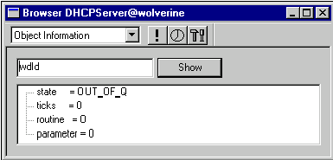
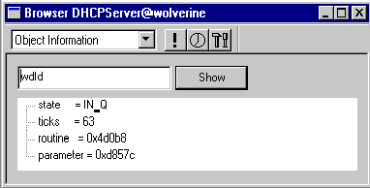
Watchdog Browser
After creating, but prior to activating the watchdog, the Browser provides minimal information:
After activating the watchdog, more useful information is provided:

Slide 31
Polling Issues
Can poll at task time or interrupt time.
  Interrupt time polling is more reliable.
  Task time polling has a smaller impact on the rest of the system.
To poll at task time, there are two options:
  taskDelay( ) : faster, but may “drift”.
  wdStart( ) + semGive( ) : more robust.

Slide 32
Polling Caveats
The following code is accurate only if the system clock rate is a multiple of 15hz:
Do not set the system clock rate too high, because there is OS overhead in each clock tick.
Use auxiliary clock to poll at high speeds.
void myWdISR ( )
{
wdStart (myWdId, sysClkRateGet()/15, myWdISR, 0);
pollMyDevice();
}

Slide 33
Auxiliary Clock
For high speed polling, use the auxiliary clock.
Precludes using spy, which also uses the auxiliary clock.
Some routines to manipulate auxiliary clock:
  sysAuxClkConnect( ) Connect ISR to Aux clock.
  sysAuxClkRateSet( ) Set Aux clock rate.
  sysAuxClkEnable( ) Start Aux clock.
  sysAuxClkDisable( ) Stop Aux clock.
Notes:
Some boards do not have an auxiliary clock.
The maximum and minimum rates for the auxiliary clock are given in config.h.

Slide 34
Summary
Using signals for exception handling:
  signal( )
  exit( )
  taskRestart( )
  longjmp( )
Interrupt Service Routines have a limited context:
  No Blocking
  No I/O system calls

Slide 35
Summary
Polling with timers:
low speed high speed
Interrupt
time
task
time
wd timer aux clock
taskDelay, or
wd timer + semGive

